Slide 1
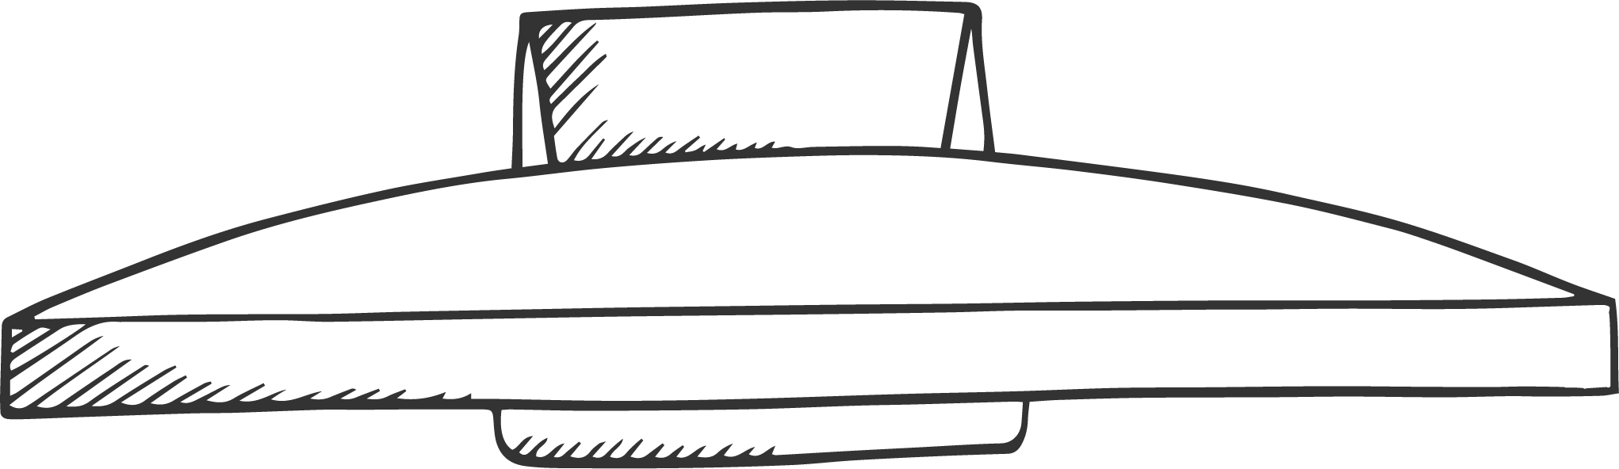



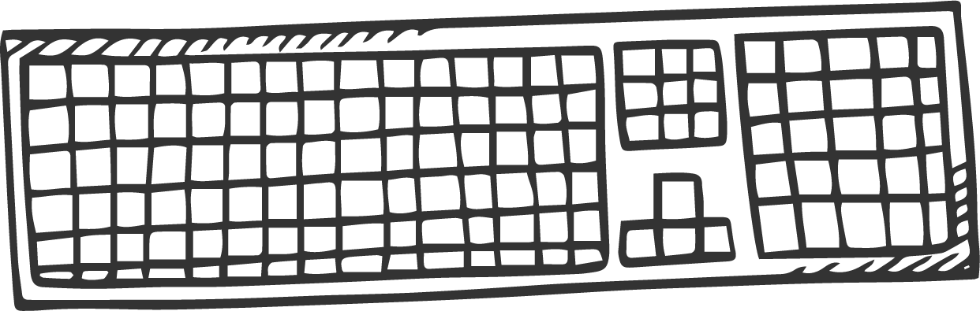
A Fast and Accurate One-Stage Approach to Visual Grounding
汇报人：徐昕

Slide 2


1
Two-stage visual grounding
Contents
2
One-stage visual grounding
3
Experiments
4
Conclusion

Slide 3
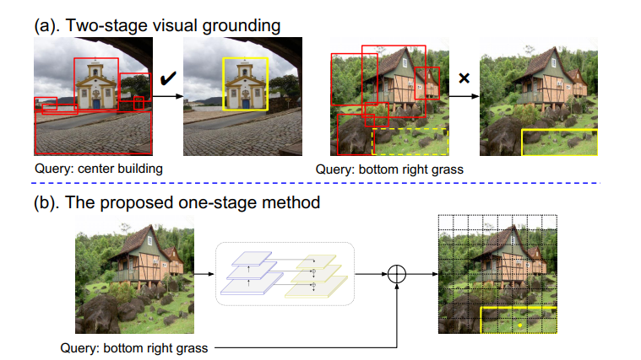
Two-stage visual grounding
Problems:
The performances of existing propose-and-rank two-stage methods are capped by the quality of the region candidates they propose in the first stage
Most of the computation spent on the region candidates, such as generating proposals, extracting features, fusing with the query embedding, scoring similarities, and so on, are merely to rank them down to the list. After all, in most test cases, only one or two region proposals are correct.

Slide 4
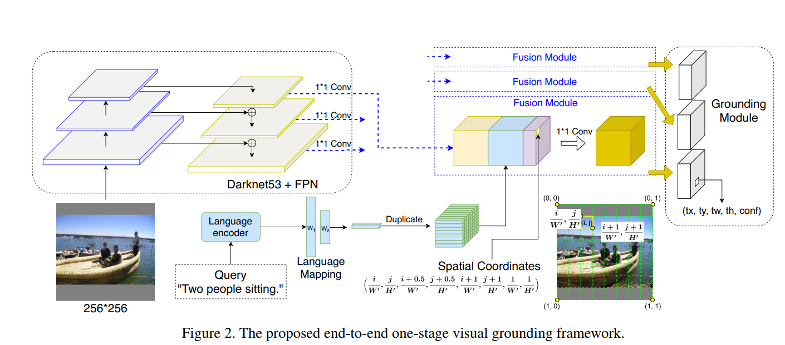
One-stage visual grounding
The main idea: merge language queries and spatial features into the YOLOv3 object detector and
build an end-to-end trainable visual grounding model
Innovations：
augment the feature maps with spatial features
replace the sigmoid output layer with a softmax function

Slide 5
Approach
Visual feature encoding:
use Darknet-53 with feature pyramid networks to extract visual features for the input image,which is resized to 256 × 256, at three spatial resolutions:8×8×D1, 16×16×D2, and 32×32×D3. There are D1 = 1024, D2 = 512, and D3 =
256 feature channels at the three resolutions, respectively.We add a 1 × 1 convolution layer with batch normalization
and RELU to map them all to the same dimension D = 512 text feature encoding:
embed text query to a 768D real-valued vector using the uncased version of Bert, followed by two fully connected layers either with 512 neurons
Fusion:
first broadcast the query embedding to each spatial location (i, j) and then concatenate it with the visual and spatial features, giving rise to a 512 + 512 + 8 = 1032D feature vector. normalized respectively before the concatenation. We add
a 1 × 1 convolution layer to better fuse them at each location independently, After this fusion step, we have a 512D feature
vector for each location of the three spatial resolutions
Grounding:
The grounding module takes the fused features as input and generates a box prediction to ground the language query onto an image region.

Slide 6
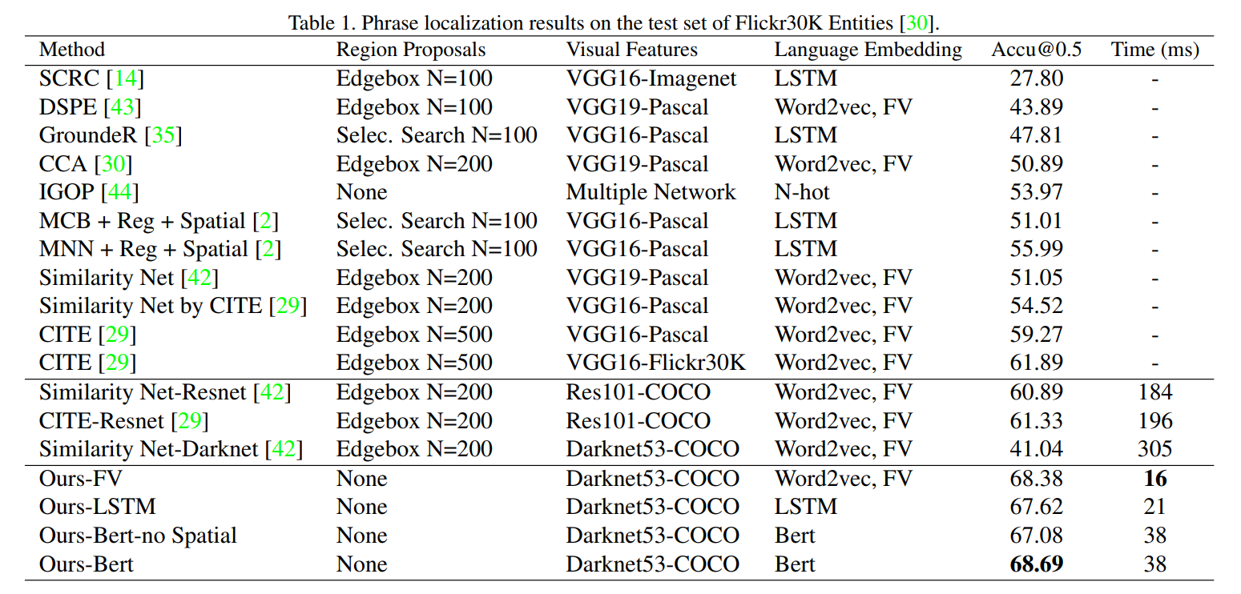

Slide 7
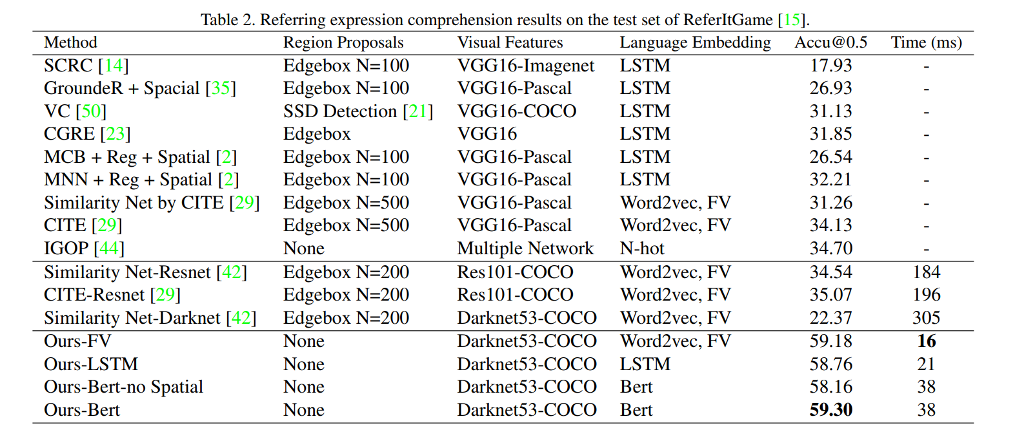

Slide 8
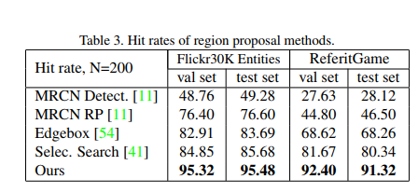

Slide 9
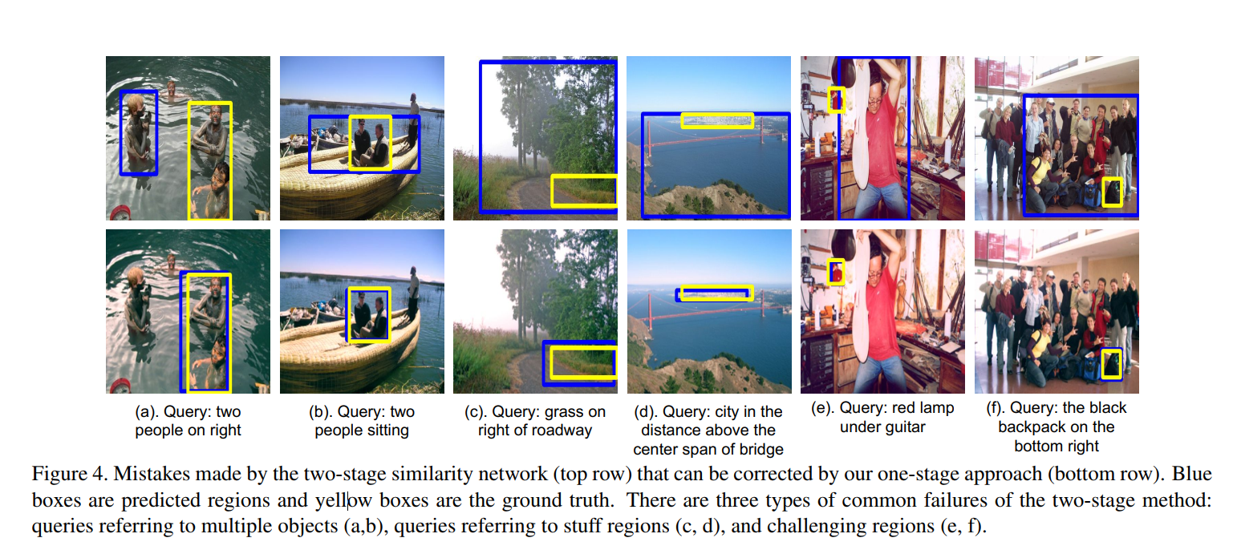

Slide 10
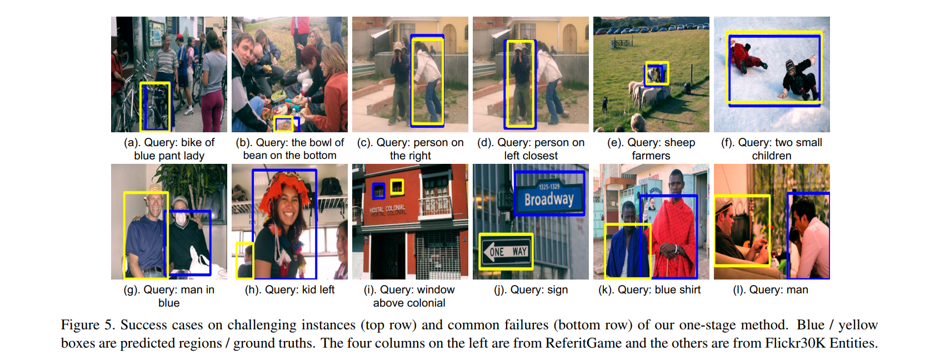

Slide 11
Conclusions
10 times faster than state-of-the-art two-stage methods
achieves superior grounding accuracy
existing region proposal methods are generally not good enough, capping the performance of the two-stage methods and indicating the need of a paradigm shift to the one-stage framework

Slide 12
感谢观看！

